Slide 1
Lecture : 19
Linear Regression Supervised Learning with Gradient Descent
Abdullah Mansoor

Slide 2
Supervised Learning
Components of Supervised Learning Setup:
Labeled Data
Hypothesis/Model (to be learned)
Cost Function
Optimizer

Slide 3
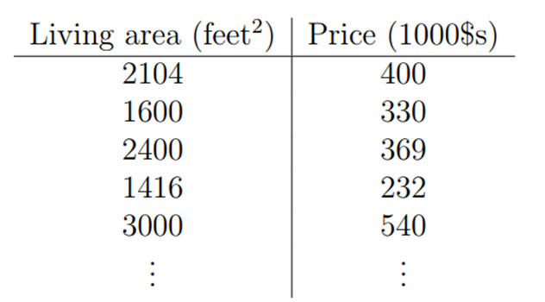
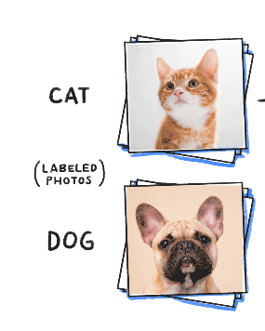
Supervised Learning
Labeled Data
Hypothesis/Model
A mathematical representation of the problem
Y = h_{θ}(x) =θ₀+θ₁x₁
It actually is the machine learning algorithm
Takes an example as input and gives a predicted value as output
Learning:
Values of the parameters in the hypothesis are needed to be set such that we have the prediction as close to the original label
Cost Function
How would we know how much right the prediction was made?
Measures the accuracy of the predictions made across the complete data
(h_{θ}(x) – y)²
The value provided by the cost function is needed to be minimized as it is error.
Optimizer
An algorithm that iteratively reduces the value of cost function by updating the values of parameters in the hypothesis

Slide 4
Supervised Learning
Types of Supervised Learning
Regression
Prediction of a continuous value
Examples: How much rain fall? Price? Marks?
Classification
Cat or Dog

Slide 5
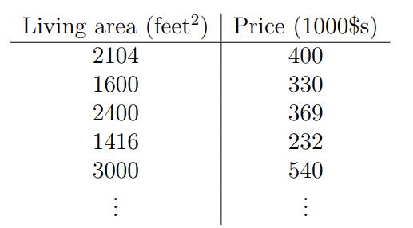
Price Prediction Simple Linear Regression
Problem:
House price prediction.
Goal:
Learn a function h, which is a good predictor of the price if given living area.
Hypothesis/Model:
How to represent this function?
Linear relationship b/w area and price
Solution: Linear Regression
Let’s say, y is a linear function of x.
Y = h_{θ}(x) =θ₀+θ₁x₁
θ_{j}’s are the parameters(also called weights)
So, prediction is == line fitting
Price
Living Area

Slide 6
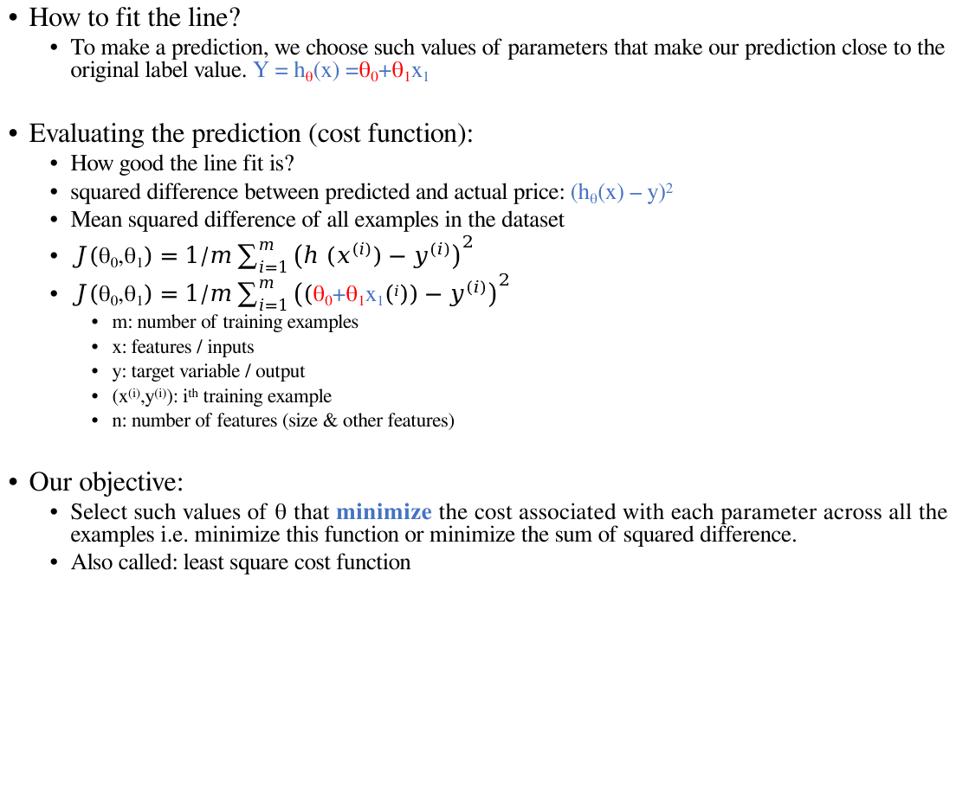
How to fit the line?
To make a prediction, we choose such values of parameters that make our prediction close to the original label value. Y = h_{θ}(x) =θ₀+θ₁x₁
Evaluating the prediction (cost function):
How good the line fit is?
squared difference between predicted and actual price: (h_{θ}(x) – y)²
Mean squared difference of all examples in the dataset
$J\left(\text{θ}\text{0}\text{,}\text{θ}\text{1}\right)=1/m\sum_{i=1}^{m}{{\left(h (x^{\left(i\right)})−y^{(i)}\right)}^{2}}$
$J\left(\text{θ}\text{0}\text{,}\text{θ}\text{1}\right)=1/m\sum_{i=1}^{m}{{\left((\text{θ}\text{0}\text{+}\text{θ}\text{1}\text{x}\text{1}\left(i\right))−y^{(i)}\right)}^{2}}$
m: number of training examples
x: features / inputs
y: target variable / output
(x^{(i)},y^{(i)}): i^{th} training example
n: number of features (size & other features)
Our objective:
Select such values of θ that minimize the cost associated with each parameter across all the examples i.e. minimize this function or minimize the sum of squared difference.
Also called: least square cost function

Slide 7
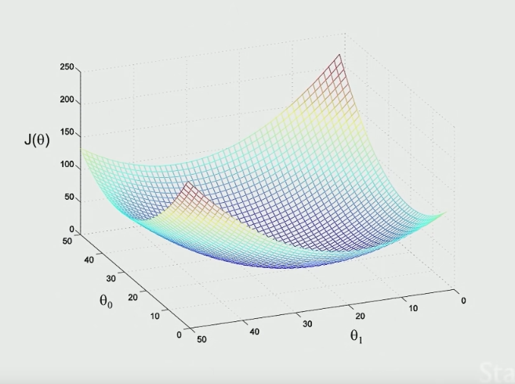

Visualizing – Cost Function
Why this function?
A differentiable function.
A convex function.
A non-convex function:
.
Easier to minimize.
$$J\left(\text{θ}\text{0}\text{,}\text{θ}\text{1}\right)=1/m\sum_{i=1}^{m}{{\left(h (x^{\left(i\right)})−y^{(i)}\right)}^{2}}$$

Slide 8

Minimizing the cost function
Derivative/Gradient of Cost Function:
Gives the direction where the value is decreasing
Automating this procedure of iterative reduction in the cost function / iteratively minimizing the cost function
Gradient Descent!
$$J\left(\text{θ}\text{0}\text{,}\text{θ}\text{1}\right)=1/m\sum_{i=1}^{m}{{\left(h (x^{\left(i\right)})−y^{(i)}\right)}^{2}}$$
$\frac{\text{∂}}{\text{∂}\text{θ}\text{j}}$ $J\left(\text{θ}\text{0}\text{,}\text{θ}\text{1}\right)$

Slide 9
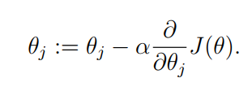
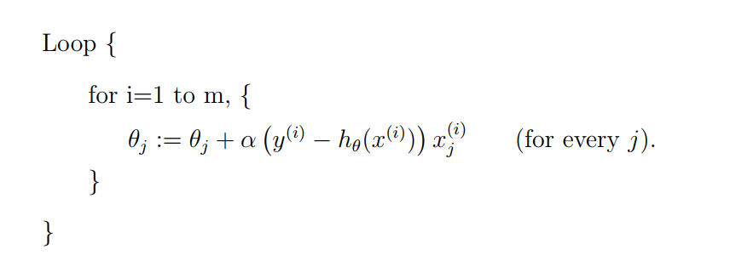
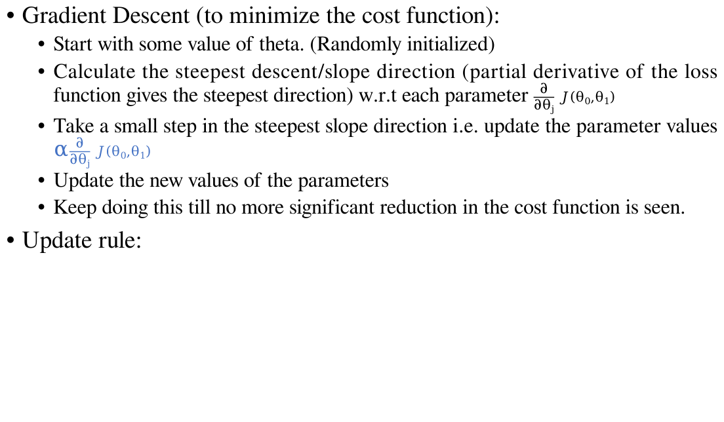
Gradient Descent (to minimize the cost function):
Start with some value of theta. (Randomly initialized)
Calculate the steepest descent/slope direction (partial derivative of the loss function gives the steepest direction) w.r.t each parameter $\frac{\text{∂}}{\text{∂}\text{θ}\text{j}}$ $J\left(\text{θ}\text{0}\text{,}\text{θ}\text{1}\right)$
Take a small step in the steepest slope direction i.e. update the parameter values α$\frac{\text{∂}}{\text{∂}\text{θ}\text{j}}$ $J\left(\text{θ}\text{0}\text{,}\text{θ}\text{1}\right)$
Update the new values of the parameters
Keep doing this till no more significant reduction in the cost function is seen.
Update rule:
Repeatedly do this:
For each training example
New value of this parameter
Old value
How big the step
We want to take
In this direction
For each feature in the example

Slide 10
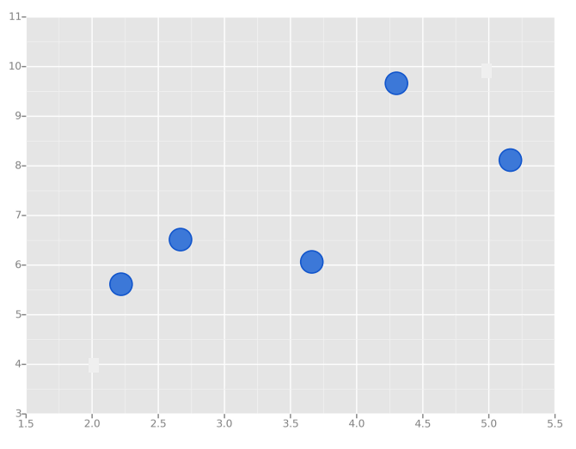
Visualizing the line fitting:

Slide 11
Visualizing the line fitting:

Slide 12
Variants of GD
Batch Gradient Descent
Stochastic Gradient Descent (Online Learning)
Mini Batch Gradient Descent

Slide 13
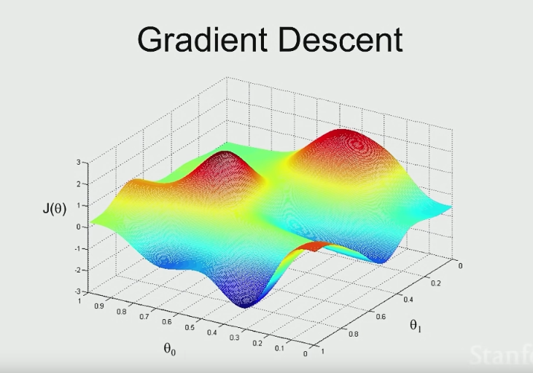
GD Details
Multiple minima
Local minima
Global minima
Learning rate
Step size – alpha
Too small = slow training
Too large = may not converge

